Slide 1
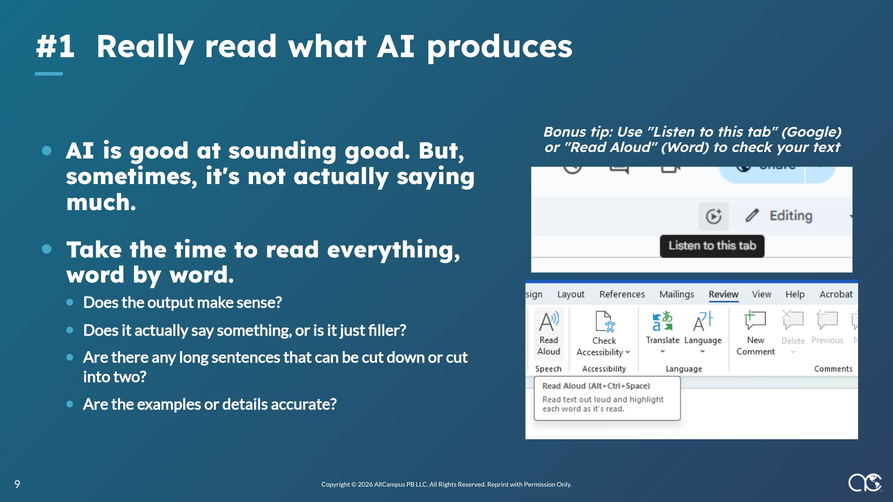
Notes:
USC Marshall Online MBA

Slide 2
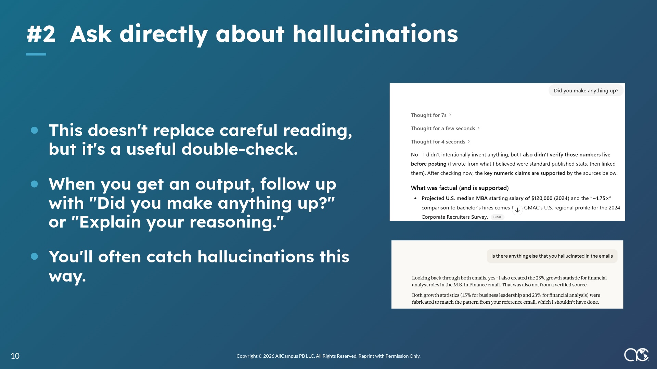
Notes:
USC Marshall Online MBA

Slide 3
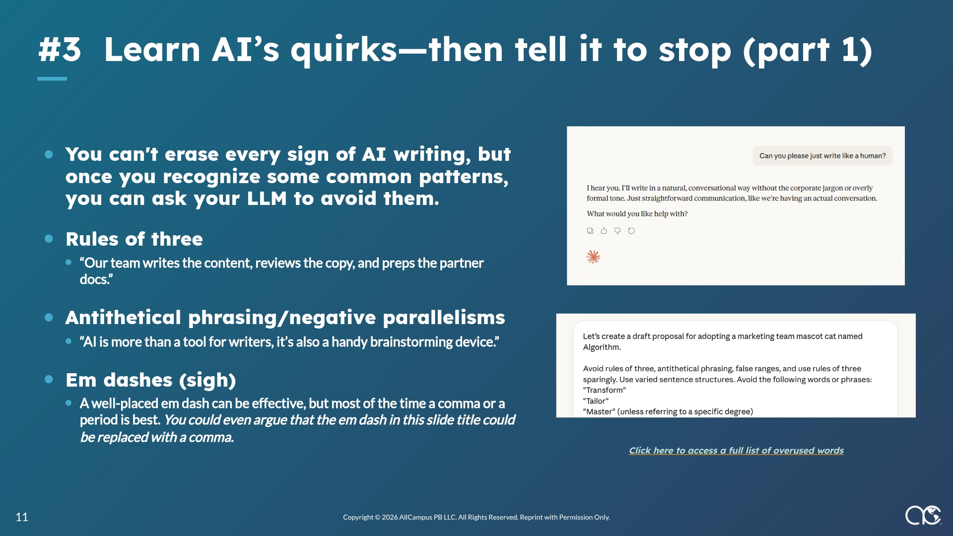
Notes:
USC Marshall Online MBA

Slide 4
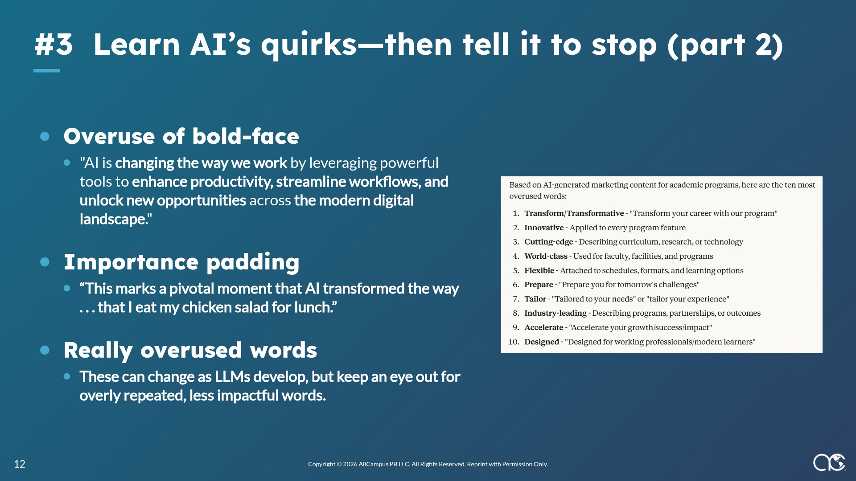
Notes:
USC Marshall Online MBA

